Slide 1

Enhancing Predictive Performance for UCI ML Bank Marketing Dataset
Presenter: Irfan Arshad

Slide 2

UCI ML Bank Marketing Dataset Overview: Client interaction and subscription dataset. Demographic info, economic indicators. Predictive Modeling in Bank Marketing: Enhances targeted marketing. Optimizes resource allocation. Improves campaign effectiveness.
Introduction:

Slide 3

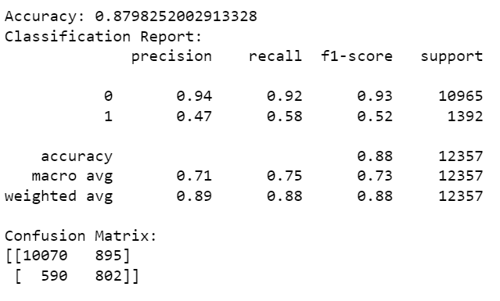
Current Model Performance:

Slide 4
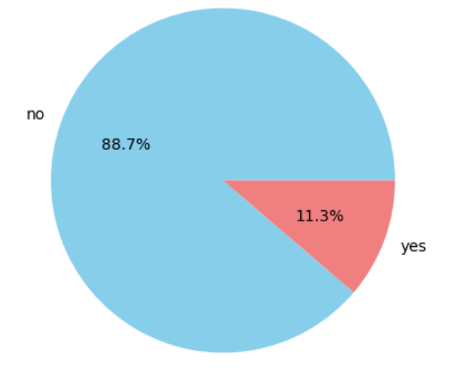
Identified Challenges:
Class Imbalance:
Majority of instances are not subscribed.
Imbalance impacts model learning and predictions.
Biases in the Dataset:
Socioeconomic biases and data skewness.
Influence model predictions, particularly for subscriptions.
Distribution

Slide 5

Addressing Class Imbalance:
Imbalance Issue Explanation:
Majority in 'not subscribed' class.
Model may favor accuracy but struggle with minority class predictions.
Concrete Steps:
Oversampling:
Class Weight Adjustment

Slide 6

Model Fine Tuning:
Importance:
Optimize model for better predictive performance.
Steps:
Grid Search with Cross-Validation:
Algorithm Experimentation:

Slide 7
Feature Engineering:
Enriching Feature Set:
Enhance model understanding and predictive power.
Specific Steps:
Age Binning:
Transform continuous age variable into bins.
Interaction Terms:
Introduce terms capturing combined effects of relevant features.
One-Hot Encoding:
Convert categorical variables like job type using one-hot encoding.

Slide 8
Additional Data Collection:
Importance:
Enhance model insights with a broader dataset.
Steps:
Subscription History:
Gather historical data on clients' subscription behavior.
Demographic Details:
Obtain additional information like marital status or household size.
Economic Trends:
Incorporate macroeconomic indicators for a broader context.

Slide 9
Conclusion:
Summary of Strategies:
Addressed class imbalance and biases, and improved feature set.
Continuous Improvement:
Emphasize the need for ongoing monitoring and adaptation.
Goal:
Create a more robust, accurate, and ethically sound predictive model for bank marketing.

Slide 10
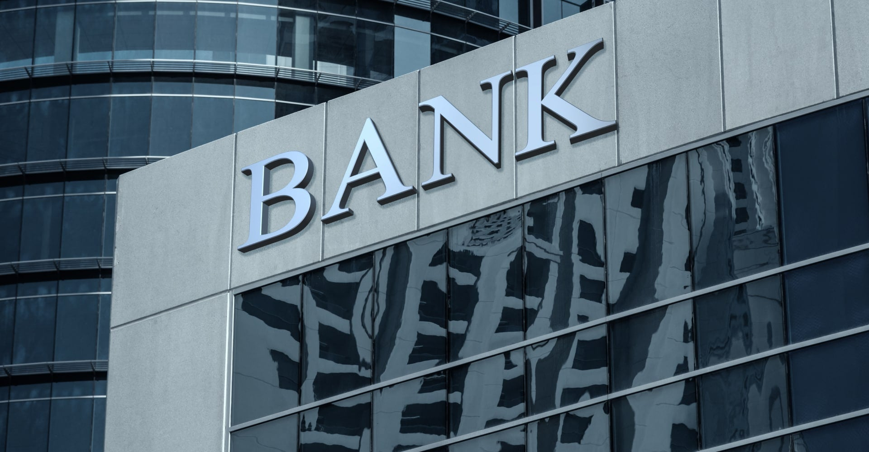
Questions & Answers
Large Image Slide

Slide 11





Thank You
April Hansson
+44 1239 876 554
april@contoso.com

